Slide 1

Fourth session
Introduction to machine learning

Slide 2

Session outline
Go through homework
Metrics for evaluating ML
Unsupervised methods
K-means
Briefly on natural language processing
Activities

Slide 3
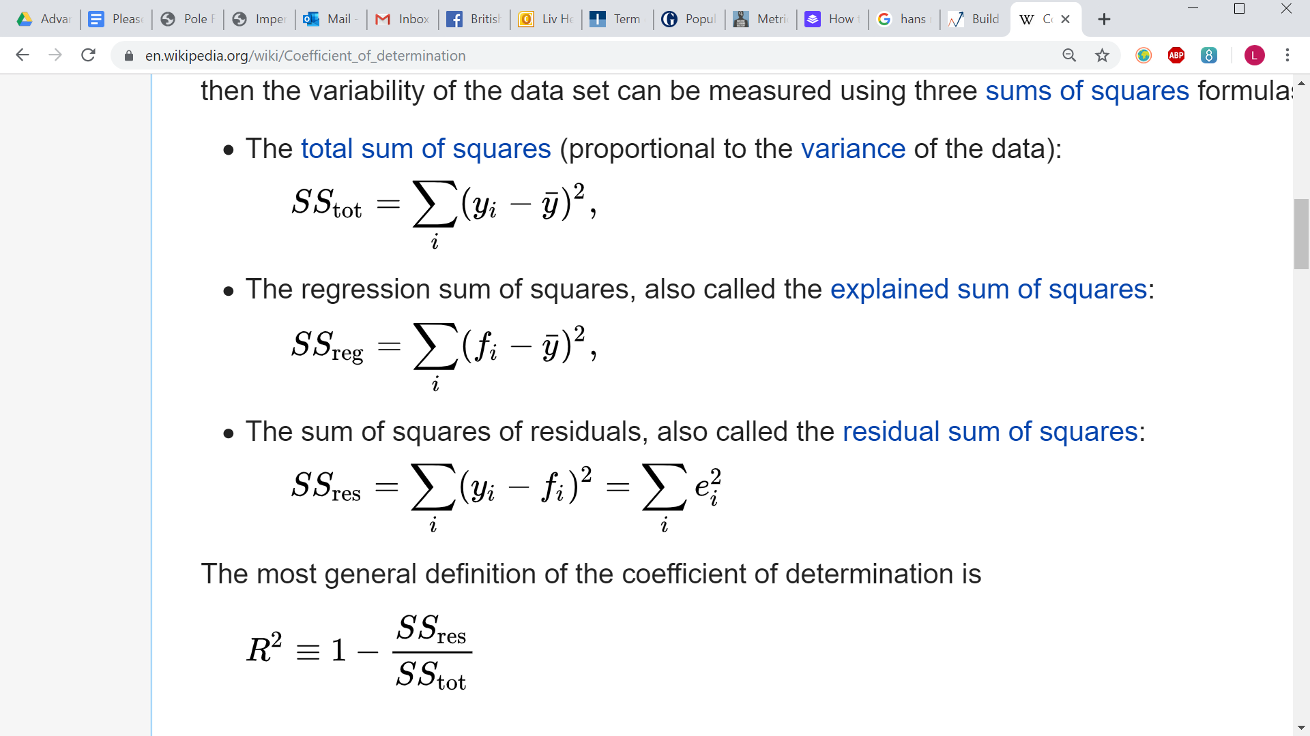
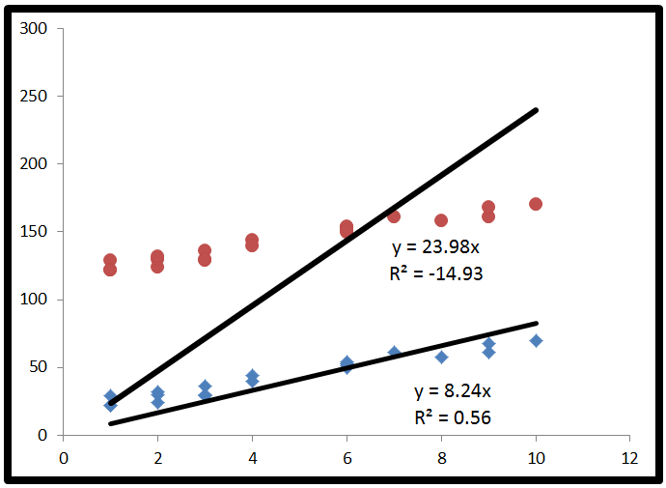

R squared

Slide 4
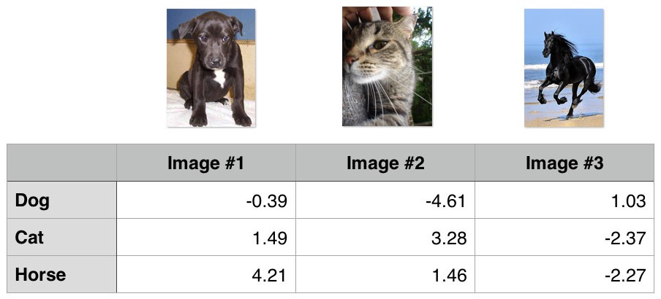
Errors for categorical ML
Categorical cross entropy
Confusion matrix

Slide 5
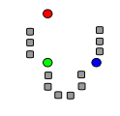
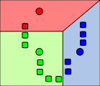
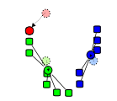
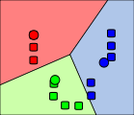
K-means
Starts with k random cluster centres
Calculates the distance between each point and centre – each point belongs to the category of the closest centre
The centre of the new categories now become the new mean
Repeat
It can be used for more than two dimensions, but this is difficult to visualise

Slide 6
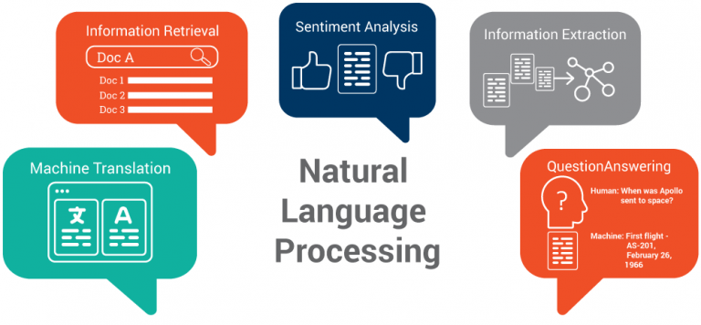
Natural language processing (NLP)
Sentiment analysis
Bag of words
Stemming
Term frequency

